Slide 1
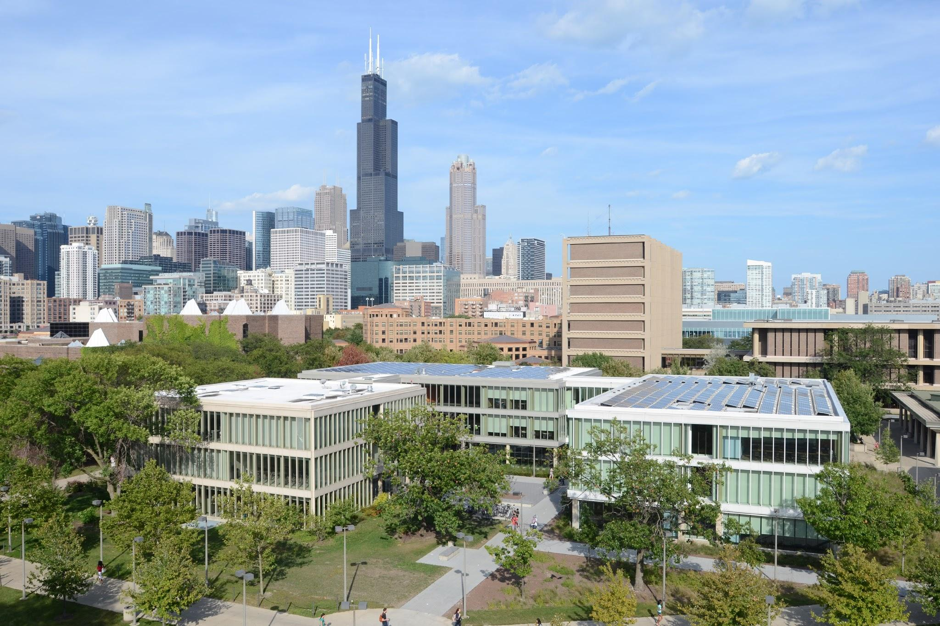
ACADEMIC ADVISING
Computer Science

Slide 2
Bit.ly/CS_Advising
Open Advising Hours: CS Student Lounge (SEL 2268)
Monday through Friday: 10-12 & 2-4
Joshua Taylor joshualt@uic.edu
Last Name A-Huk SEO Office 913
Kailin Potter Kpotter@uic.edu
Last Name Hul-J,Patel SEO Office 919
Bryant Hill
bhill11@uic.edu Last Name: K,Patel-Z SEO Office 923

